Slide 1

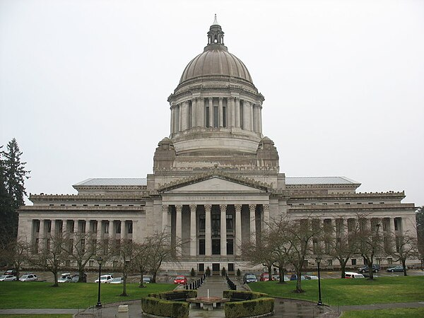

How a bill becomes a law
A Data Study of Washington State Lobbying Activities from 2016 to Present
Anthony Graffigna

Slide 2
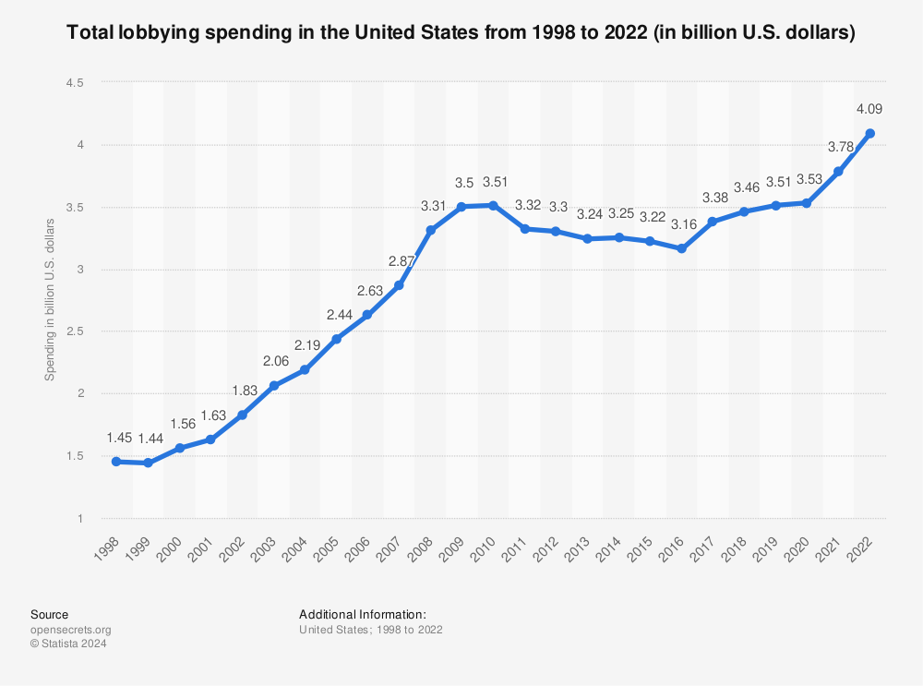
What is Lobbying?
Annually, billions of dollars are spent by businesses, interest groups, non-governmental organizations, and private citizens alike to hire lobbyists
Lobbyists speak with various governmental bodies and committees in order to influence their actions, policies, and decisions
Lobbyists also work to support political campaigns through various avenues
Lobbyists meet with legislators, elected officials, members of regulatory agencies, and judges to represent the views of the organization that hired them
Source: https://www.statista.com/statistics/257337/total-lobbying-spending-in-the-us/

Slide 3

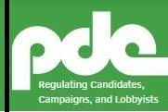
Lobbying in Washington State
Firms who hire professional lobbyists to operate in the state of Washington are required to report the compensation and expenses to the Public Disclosures Commission, or PDC
The PDC maintains a dataset containing records of lobbying activity starting in 2016
The dataset contains information on over 250,000 reports
The base dataset includes:
The name of the employer hiring the lobbyist
The source of the funding
The total compensation paid out, broken down by various categories such as advertising or political contributions
The name of the lobbyist (contractor) hired
Additionally, each item links out to a webpage containing the original report that was submitted, which contains additional data such as the governmental bodies lobbied and the issue or bill being advocated for

Slide 4
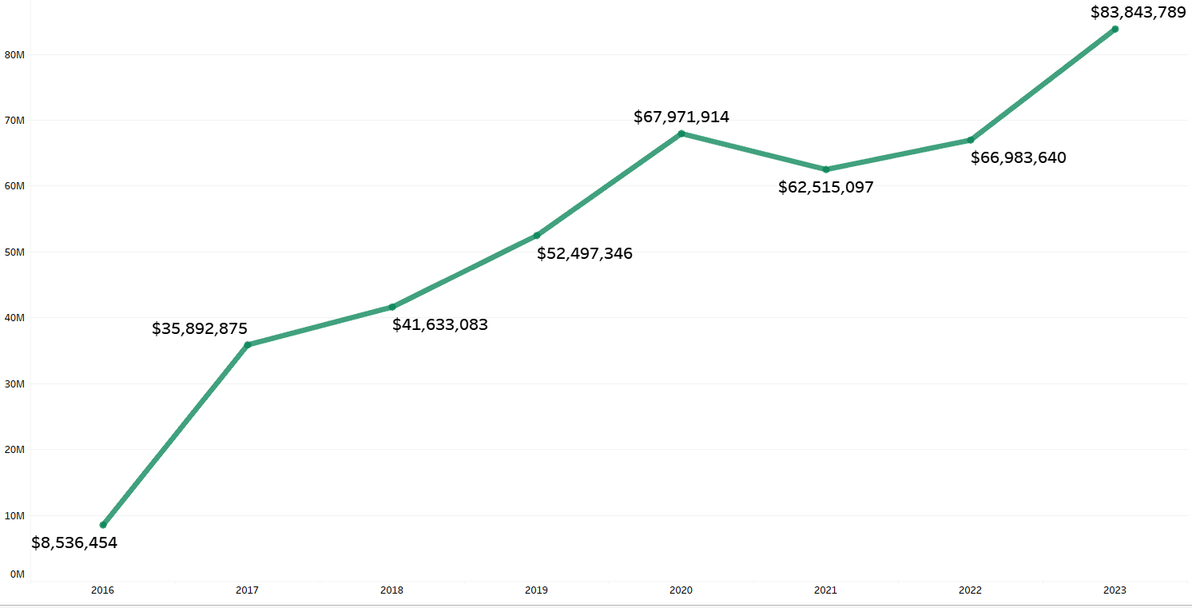
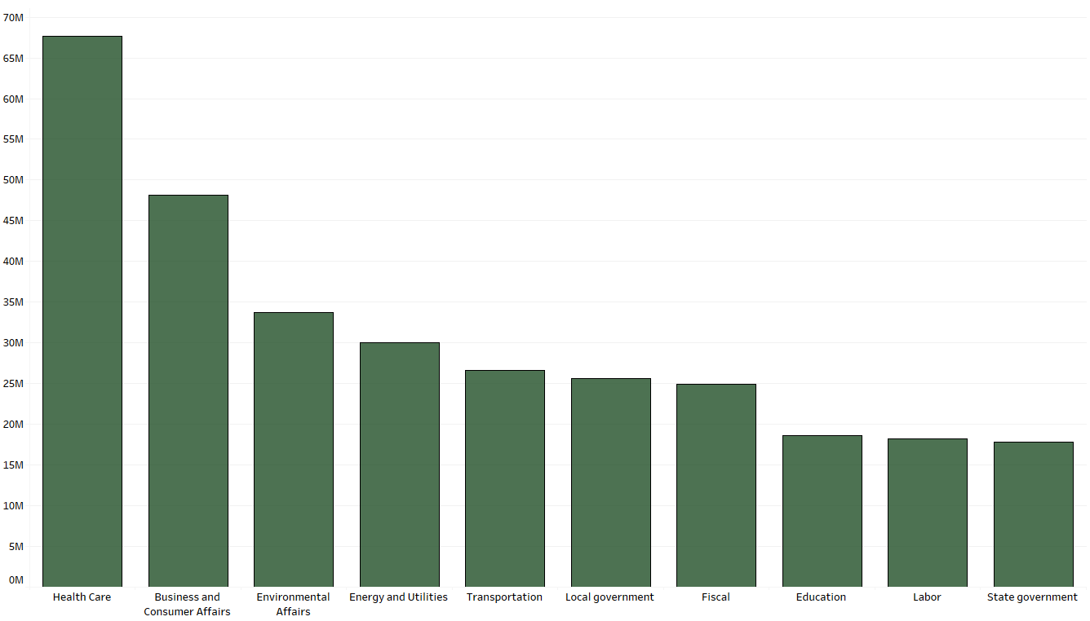
Lobbying Spend Per Year in WA
Total reported lobbying spend has increased more than tenfold since 2016
Healthcare, Business and Consumer Affairs, and Environmental Affairs are the largest categories of spending

Slide 5
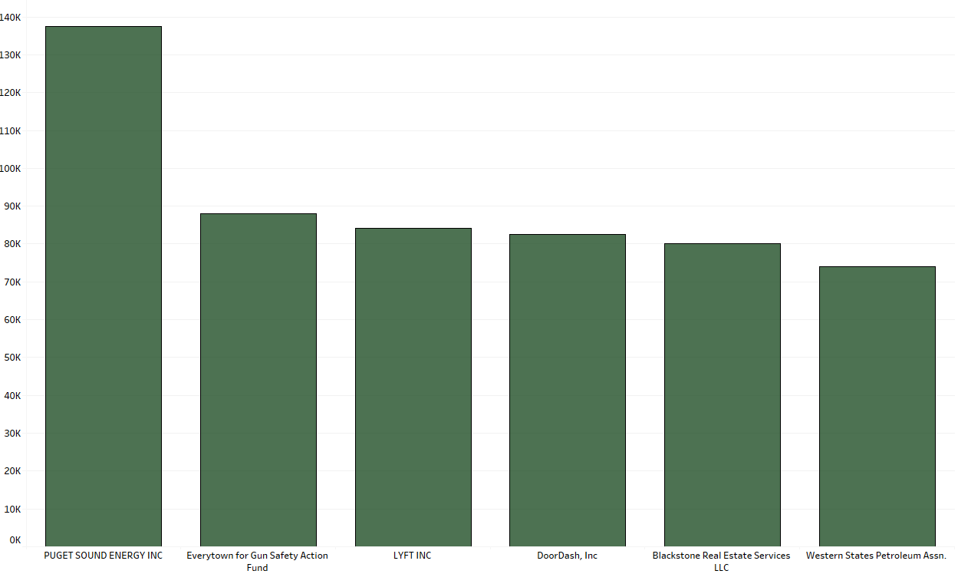
Top Spenders on Lobbying

Slide 6

Data Collection
Started by bulk downloading a CSV containing all ~260,000 records
In order to condense the scope of the analysis, filtered the data to only records where lobbyists were paid at least $200
Records with $0 compensation tend to be scenarios where a lobbyist firm incurred expenses that were not reimbursed by a client. There are ~100,000 such records in the dataset
Records with small compensation (<$200) tend to be isolated scenarios involving individuals or small interest groups. These types of lobbying activities don’t tend to “move the needle” much, and aren’t generally representative of the market as a whole.
Additionally, there are numerous records with extremely small compensation numbers that have incomplete or unspecific data
After this filtering, there are roughly 146,000 records with pertinent information for analysis
Utilizing a Python web scraper, additional information was pulled from the original reports on the PDC’s website
This includes the Subject Matter of Proposed Legislation, the Issue or Bill Number, and the Governmental Body that was lobbied
Roughly 26,000 of these records were unable to be successfully scraped, leaving us with about 120,000 records to work with

Slide 7
Example Reports
https://accesshub.pdc.wa.gov/node/104066
https://accesshub.pdc.wa.gov/node/25393

Slide 8
Limitations and Assumptions
The data reported to the PDC is manually filled out by humans. As a result, there are relatively large chunks of missing data, and inconsistences in how it is reported
Many of the original reports on the PDC website include multiple employers who hired the same lobbyist, sometimes to lobby the same body on the same issue. When cross referencing the dataset with these reports, it is very difficult to exhaustively identify all lobbying activity associated with a particular combination of funding source, lobbyist, issue or bill, and government body.
Many times, lobbyists will be paid to speak to the same body about multiple different bills or issues, and there are inconsistencies in how this is reported. This makes it difficult to exhaustively identify all bills lobbying activity was conducted on, as well as the breakdown of funds and time allocated for each bill or issue. As a result, greater emphasis is placed on lobbying activity involving a single lobbyist speaking on behalf of a single employer about a single bill or issue, as these are items we can be most confident are both accurate and have direct, measurable impact on outcomes

Slide 9
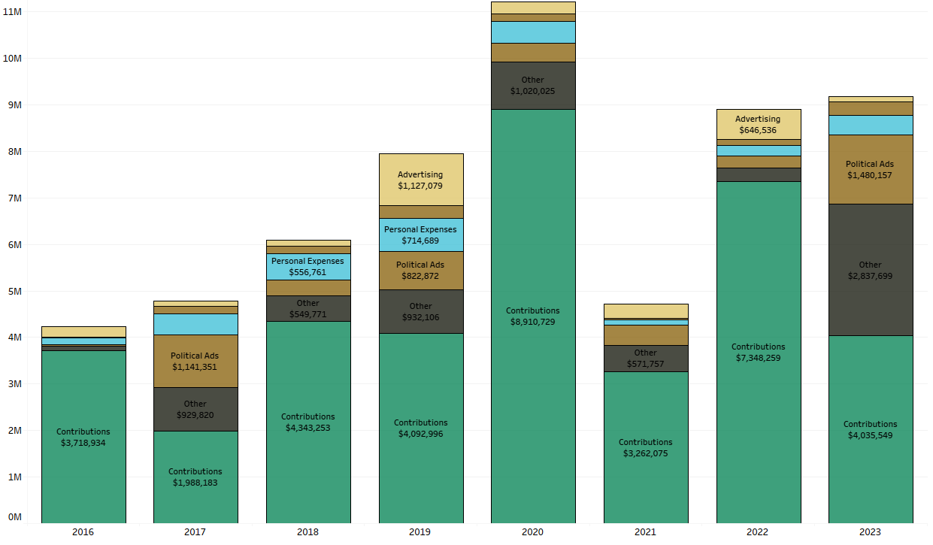
A Breakdown on Lobbying Expenses
Contributions make up the large majority of expenses
These spike during election years (even numbered years)

Slide 10
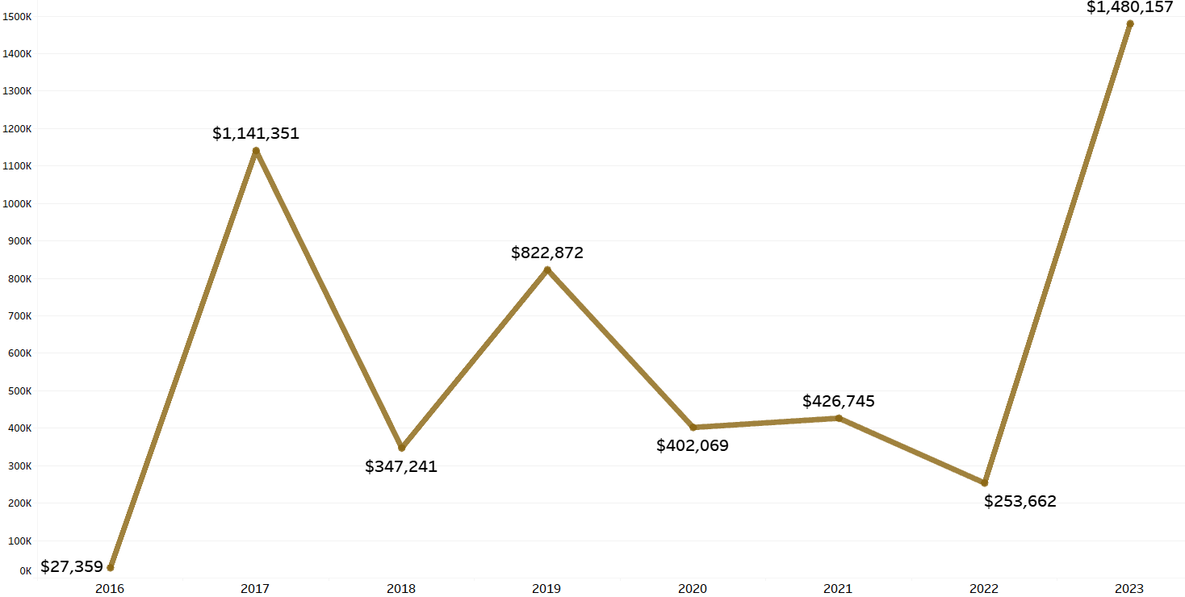
Political Ad Spend Per Year
Interestingly, political ad spend is LOWER during election years, but spikes on non-election years
WA is a relatively “blue” state, so this may indicate that political ad spend is allocated more towards local issues rather than to influence elections

Slide 11

Ok But Really… How DOES a Bill Become a Law???
3.
If the bill is passed by the committee, their report is read in an open session of the legislative body. It is then referred to the Rules Committee
7.
If amendments are made in the second house, the first house must approve the changes. When the bill is accepted in both houses, it is sent to the state governor.
1.
A bill is introduced in either the House of Representatives or the Senate by a member
5.
The bill is debated and subject to amendment before placed on the calendar for a third reading for final passage.
2.
The bill is referred to a committee for a hearing, which is open to the public. The committee can then pass, reject, or take no action on the bill
4.
The Rules Committee can either schedule a second reading of the bill for debate before the entire body, or take no action
6.
The body votes on the bill. If it passes, it is sent to the other body where the same procedure occurs.
8.
The governor signs the bill into law, or may veto all or part of it.
https://leg.wa.gov/legislature/Pages/Bill2Law.aspx#:~:text=When%20the%20bill%20is%20accepted,become%20law%20without%20a%20signature.

Slide 12


Identifying Bill Status
After collecting the Issue or Bill number associated with each report in the dataset, a subset of the data was created with all reports that involved lobbying for a specific bill
A secondary data source was acquired from LegiScan, which publishes biannual datasets containing the bills that appeared before the Washington State House and Senate, and their status
Bills are classified as:
Introduced – bills that have been introduced to a legislative body, but have been neither passed or vetoed
Engrossed – bills that have been passed by the body they were filed in and then forwarded to a second body for consideration. I.e. Passed in the Senate, and then forwarded to the House of Reps
Passed – bills that have been passed and codified into law
Vetoed – bills that have been vetoed by the body that received them, and returned to the body that passed it along with a reason for their disapproval
By cross referencing with this Bills dataset, the current status of bills that were lobbied for can be determined and used as a metric of success for both lobbyists the organizations funding them

Slide 13
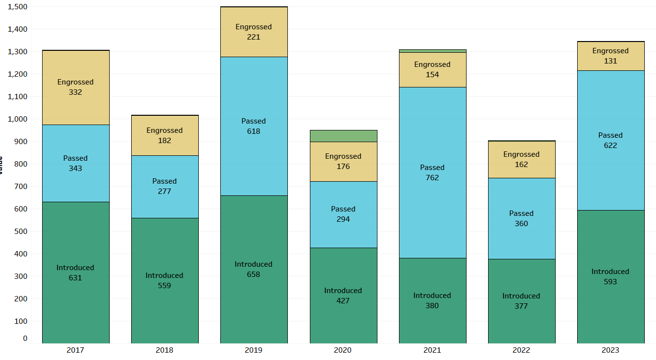
Bill Status by Year
Roughly 1000-1500 bills are introduced annually
On average, 25-50% of these bills are passed

Slide 14
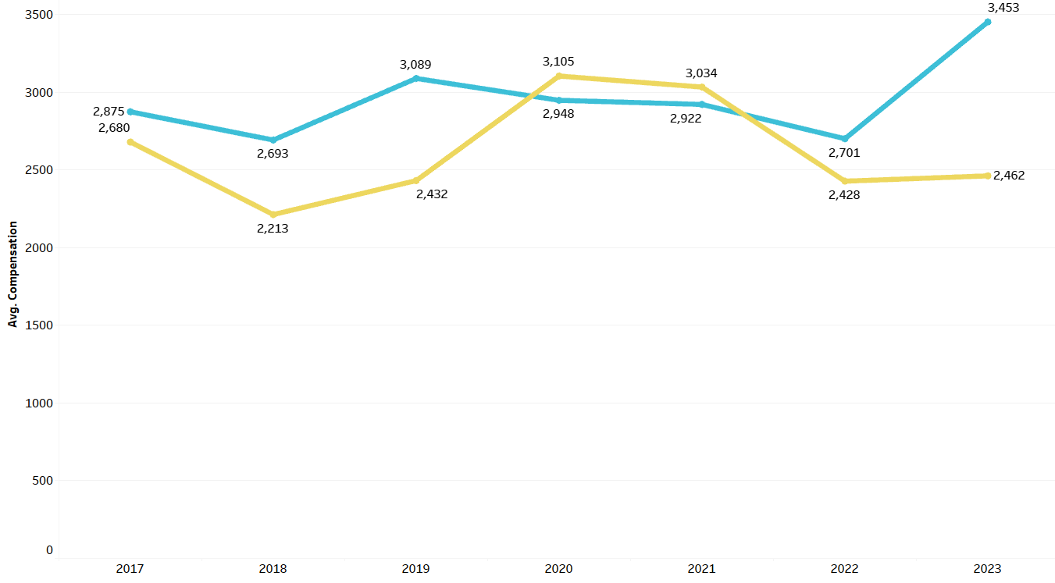
Average Total Compensation – Introduced and Passed Bills
The average total lobbying spend on bills around $3000
Generally speaking, bills that Pass receive more funding than bills that don’t pass
In 2020 and 2021, there were much greater numbers of passed bills, which can account for the spike in introduced bills over passed ones

Slide 15
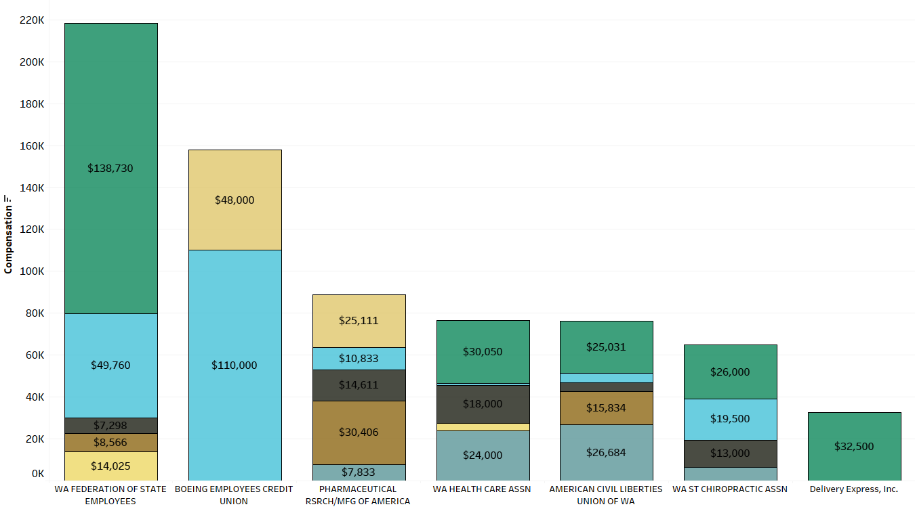
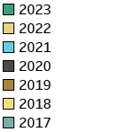
Largest Spenders on Passed Bills
The majority of the largest spenders on lobbying are representative bodies. Businesses and workers fund these associations, and in return, they hire lobbyists to represent their interests

Slide 16
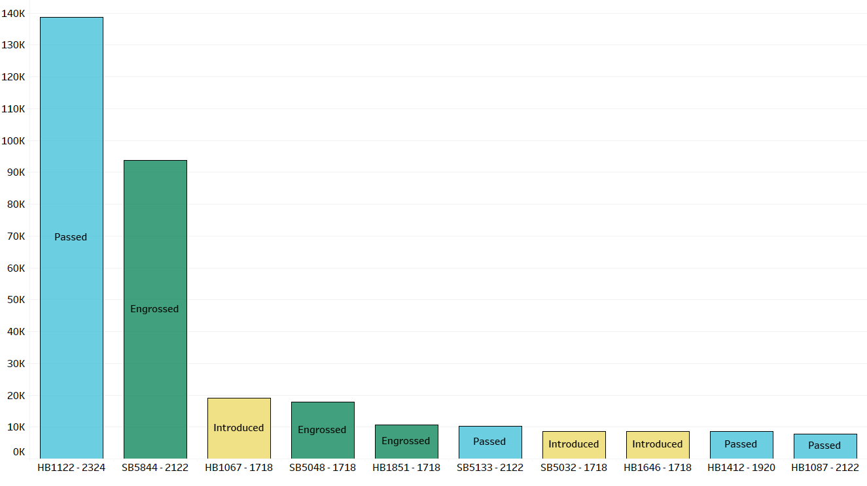
Spending Breakdown – WA Federation of State Employees
HB1122 from the year 2023-24 grants management service employees the right to collectively bargain
This is an example of a bill where large amounts of lobbying spend, representing many interested parties, resulted in the passage of a bill

Slide 17
Conclusions
Political lobbying plays a large role in influencing public policy, and total spending in the space has continually increased year over year
The largest chunk of this spending is allocated towards political contributions
Generally speaking, bills that receive larger amounts of funding for lobbyist efforts pass more often
The largest organizations that influence legislation tend to be associations that are funded by and represent many businesses or workers, and hire lobbyists on their behalf

Slide 18
Further Research
Expand research into individual issues that do not fall under a bill
Gather even more information from the original PDC reports
Conduct analysis on seasonality, the impact of elections, and the impact of other political factors on trends in funding and legislation
Create pipelines for continual ingestion of new reports via an API the PDC provides
Publish dashboard that is connected to the continually updating dataset for public use

Slide 19

Thanks!
Contact Me!
Email – anthonygraff24@gmail.com
LinkedIn - https://www.linkedin.com/in/anthonygraffigna/
GitHub - https://github.com/graffignaa
Information Sourced from:
WA State PDC, Lobbyist Compensation and Expenses - https://data.wa.gov/Politics/Lobbyist-Compensation-and-Expenses-by-Source/9nnw-c693/about_data
House and Senate Bill Data - https://legiscan.com/WA/datasets

